Slide 1
ECG Signal Denoising Using Wavelet Transform and Particle Swarm Optimization

Slide 2
Electrocardiogram (ECG) is an important signal used to monitor the heart and detect cardiovascular diseases.
ECG signals are non-stationary
ECG signal is often corrupted by noise like white Gaussian noise (WGN),power line interference (PLI)
we are using Wavelet Transform (WT) for ECG signal denoising.
To improve the denoising performance, we are using Particle Swarm Optimization (PSO)
INTRODUCTION

Slide 3
PROBLEM STATMENT
ECG signals are often corrupted by noise therefore it is necessary to denoise the signal while preserving the important information.

Slide 4
OBJECTIVE
To Denoise the ECG signals using Wavelet Transform
To use Particle Swarm Optimization (PSO) to find the optimal parameters of the Wavelet Transform.

Slide 5
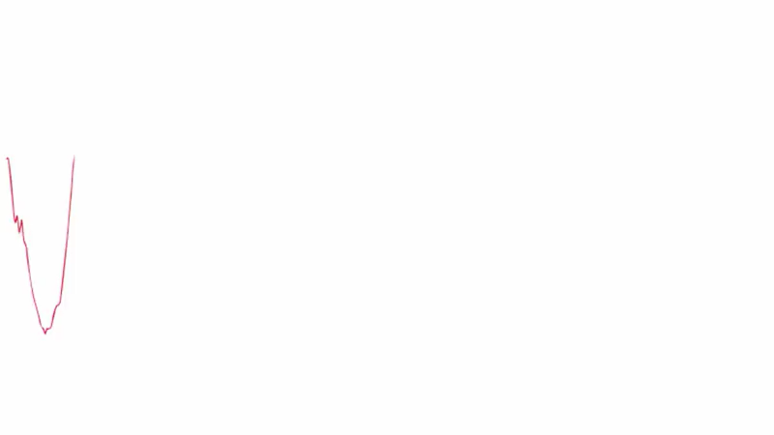

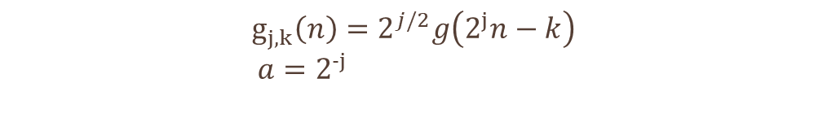
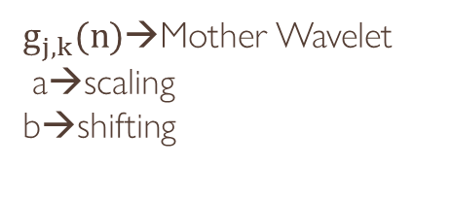
$$C(a,b)=\sum_{nεZ}{x(n)g_{j,k}(n)}$$
WT IS DEFINED AS:
$$g_{j,k}\left(n\right)=2^{j/2}g\left(2^{j}n−k\right)$$
$a=2^{−j}$
$$b={k2}^{−j}$$
X(n)→original Signal
$g_{j,k}(n)$→Mother Wavelet
a→scaling
b→shifting

Slide 6
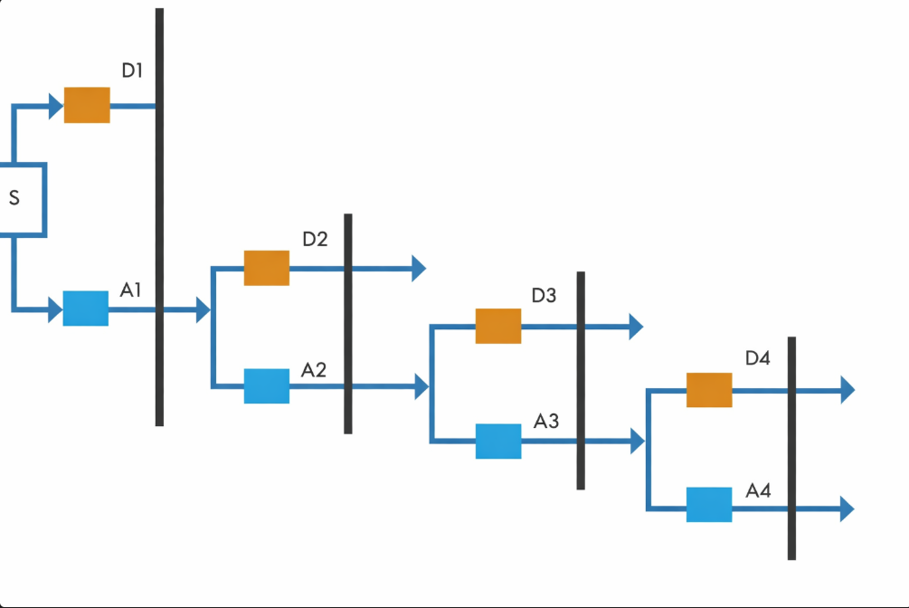
DWT
DWT

Slide 7
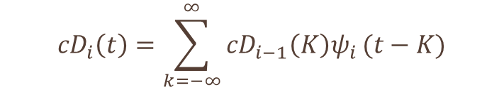
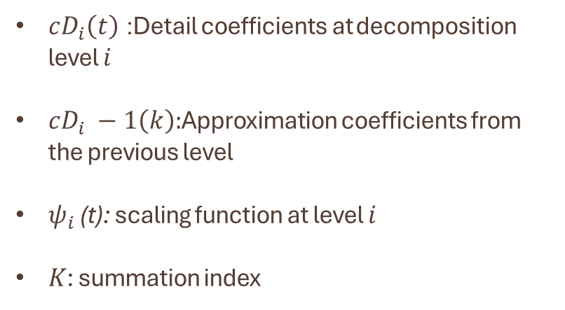
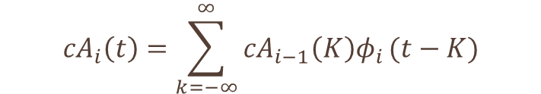
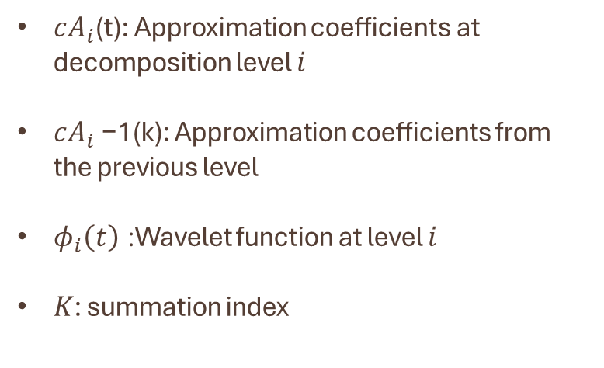
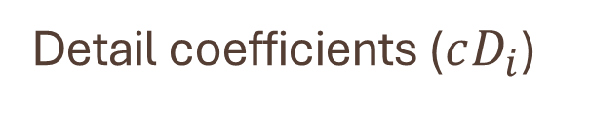
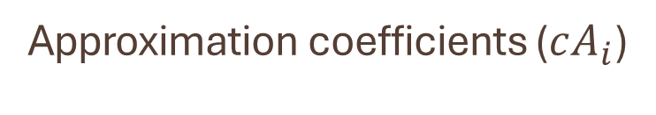
ECG Signal Decomposition:
In wavelet decomposition, approximation coefficients contain the low-frequency information of the signal, whereas detail coefficients contain the high-frequency information.
Approximation coefficients ($cA_{i}$)
Detail coefficients ($cD_{i}$)
$${cA}_{i}\left(t\right)=\sum_{k=−∞}^{∞}{{cA}_{i−1}\left(K\right)φ_{i}}(t−K)$$
$${cD}_{i}\left(t\right)=\sum_{k=−∞}^{∞}{{cD}_{i−1}\left(K\right)ψ_{i}}(t−K)$$
$cA_{i}$(t): Approximation coefficients at decomposition level $i$
$cA_{i}$−1​(k): Approximation coefficients from the previous level
$φ_{i}\left(t\right)$: Wavelet function at level $i$
$K$: summation index
$cD_{i}\left(t\right)$: Detail coefficients at decomposition level $i$
$cD_{i} −1​\left(k\right):$Approximation coefficients from the previous level
$ψ_{i}$ (t): scaling function at level $i$
$K$: summation index

Slide 8
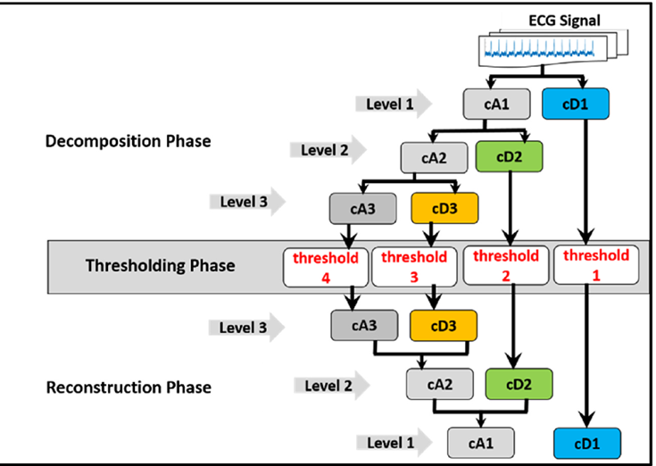
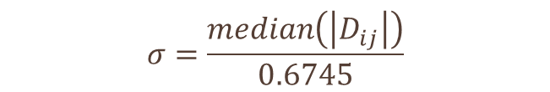
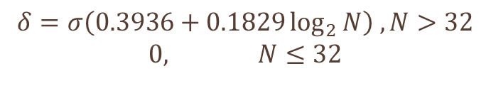
Thresholding
$$δ=σ\left(0.3936+0.1829\log_{2}{N}\right) ,N>32$$
$$0, N≤32$$
$$σ=\frac{median\left(\left|D_{ij}\right|\right)}{0.6745}$$
N is the length of the signal vector.
i → index of the coefficient
j → decomposition level

Slide 9
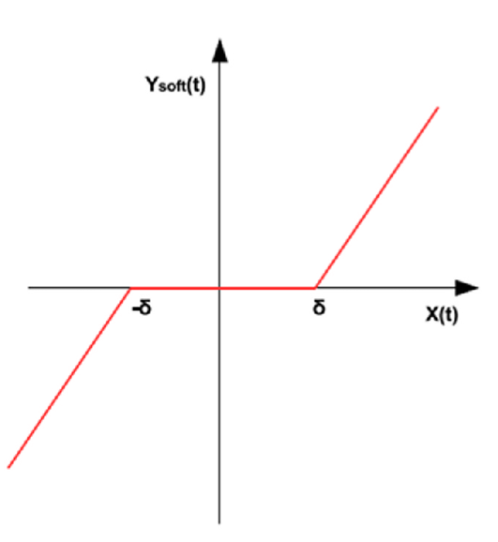
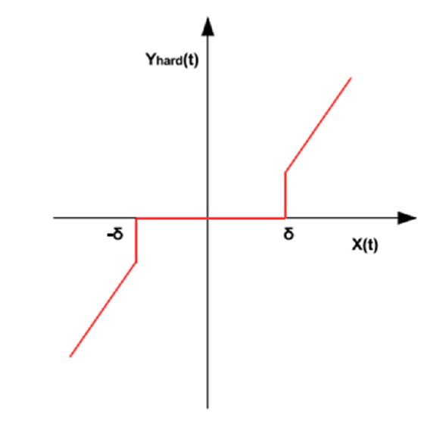




Thresholding Function
Soft Thresholding
Hard Thresholding
$$\hat{x_{di}}\left(l\right)=\hat{x_{di}}\left(l\right) \left|\hat{x_{di}}\left(l\right)\right|>δ_{l}$$
$$\hat{x_{di}}\left(l\right)=\hat{x_{di}}\left(l\right)− |δ_{l}| \left|\hat{x_{di}}\left(l\right)\right|{≥δ}_{l}$$
$$\hat{x_{di}}\left(l\right)=0 \left|\hat{x_{di}}\left(l\right)\right|<δ_{l}$$
$$\hat{x_{di}}\left(l\right)=0 \left|\hat{x_{di}}\left(l\right)\right|{<δ}_{l}$$

Slide 10
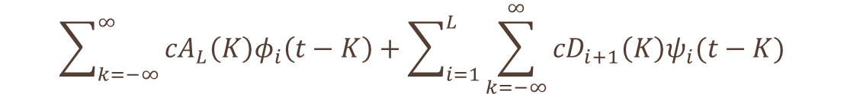
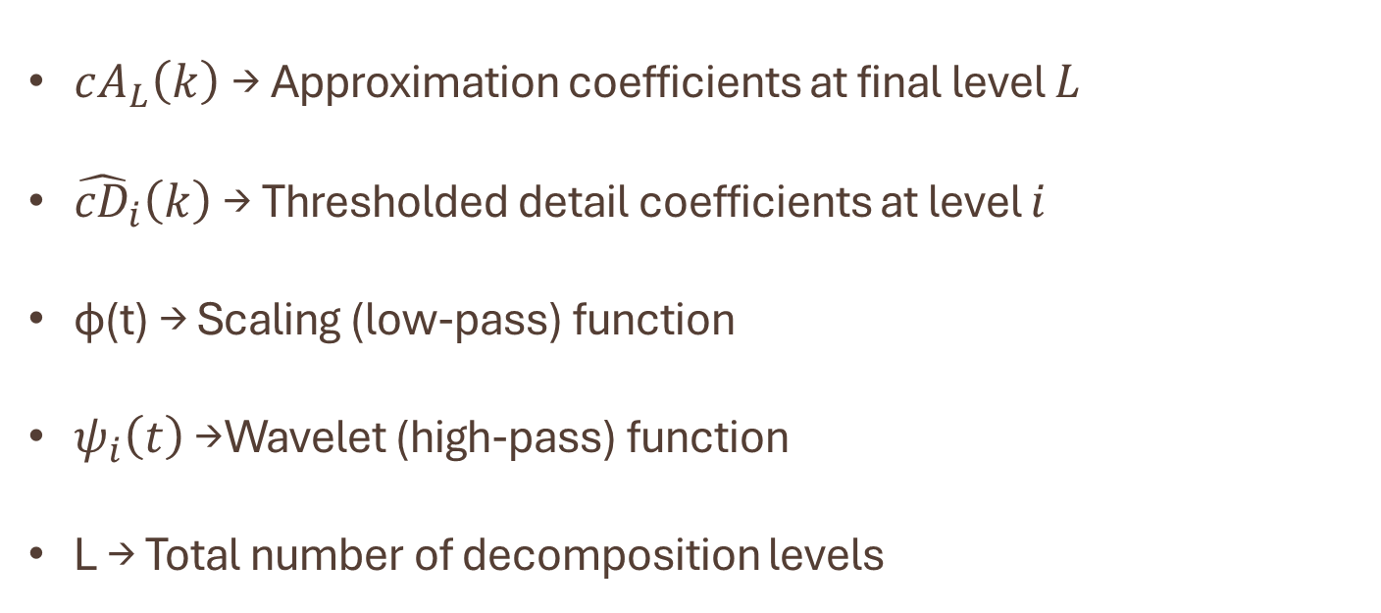
Reconstruction
$$\sum_{k=−∞}^{∞}{{cA}_{L}\left(K\right)φ_{i}\left(t−K\right)+\sum_{i=1}^{L}{\sum_{k=−∞}^{∞}{{cD}_{i+1}\left(K\right)ψ_{i}(t−K)}}}$$
ECG_denoised =
$cA_{L}\left(k\right)$→ Approximation coefficients at final level $L$
${\hat{cD}}_{i}\left(k\right)$→ Thresholded detail coefficients at level $i$
ϕ(t) → Scaling (low-pass) function
$ψ_{i}\left(t\right)$→ Wavelet (high-pass) function
L → Total number of decomposition levels

Slide 11
Particle Swarm Optimisation
PSO is an optimization algorithm used to find the best solution to a problem.
It is inspired by the behavior of birds or fish moving in groups.
When they search for food, they do not know the exact location.
But one bird may find food first.
The other birds observe its movement and move toward that area.
In PSO, many possible solutions are created and called particles.
A group of these particles is called a swarm.

Slide 12

Particle → one possible solution
Swarm → group of particles
In Each particle we have 5 parameters such as
Wavelet basis function (ϕ) - Coiflet , Symlet , Daubechies, Fejer-Korovkin and Biorthogonal
Threshold function (β) – soft ,hard
Level of decomposition (L) – 1 to 10
Threshold selection rule (λ) - Sqtwolog, Minimax, Heursure, and Rigsure
rescaling approach (ρ) - No scaling (one), one level (sln), Several levels (mln).
$$x=[φ,β,L,λ,ρ]$$

Slide 13
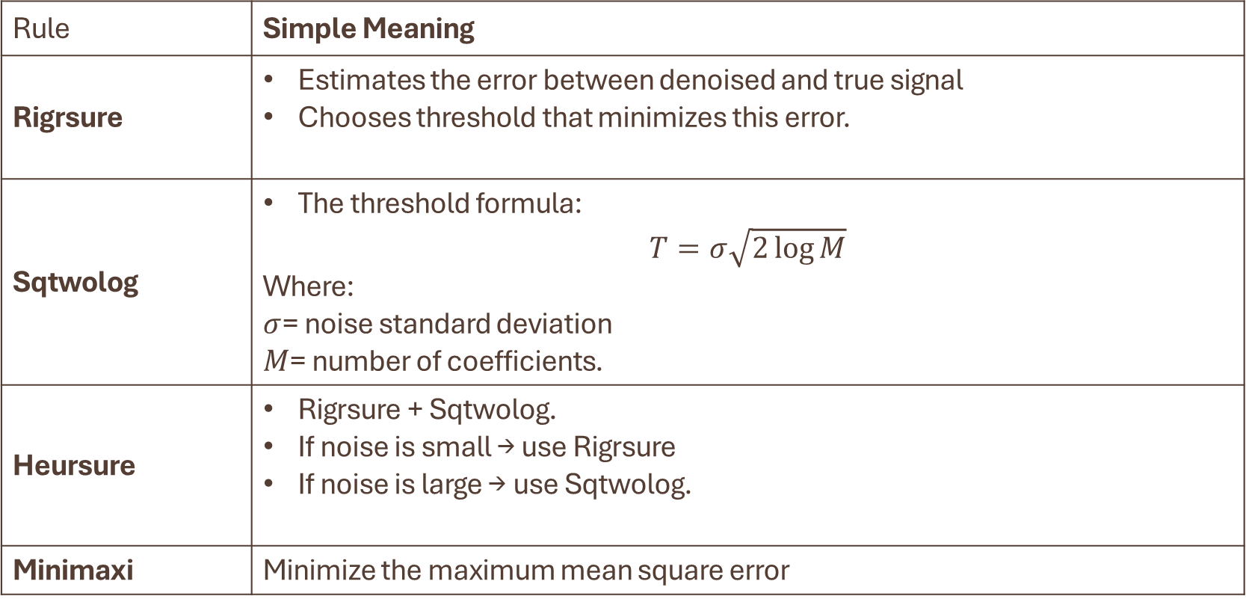
Threshold Selection Rules
Rule | Simple Meaning
Rigrsure | Estimates the error between denoised and true signal Chooses threshold that minimizes this error.
Sqtwolog | The threshold formula: $$T=σ\sqrt{2\log{M}}$$ Where: $σ$= noise standard deviation $M$= number of coefficients.
Heursure | Rigrsure + Sqtwolog. If noise is small → use Rigrsure If noise is large → use Sqtwolog.
Minimaxi | Minimize the maximum mean square error

Slide 14
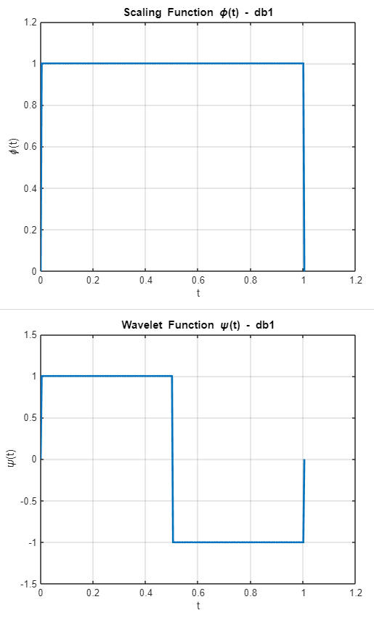
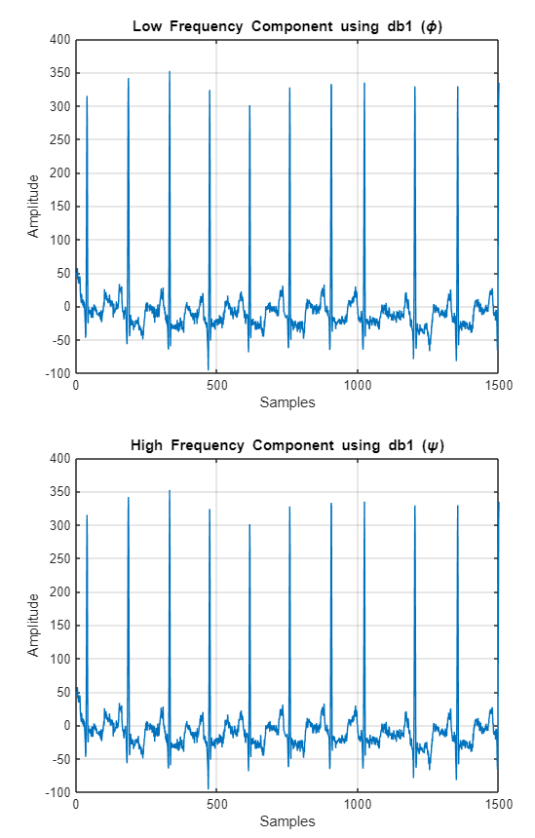
db1

Slide 15
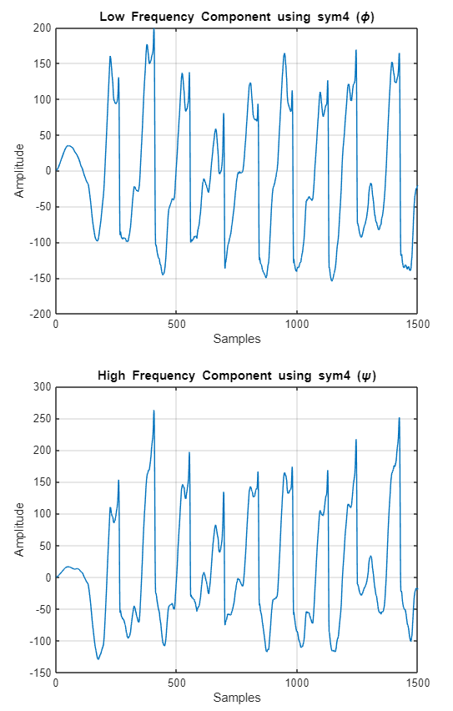
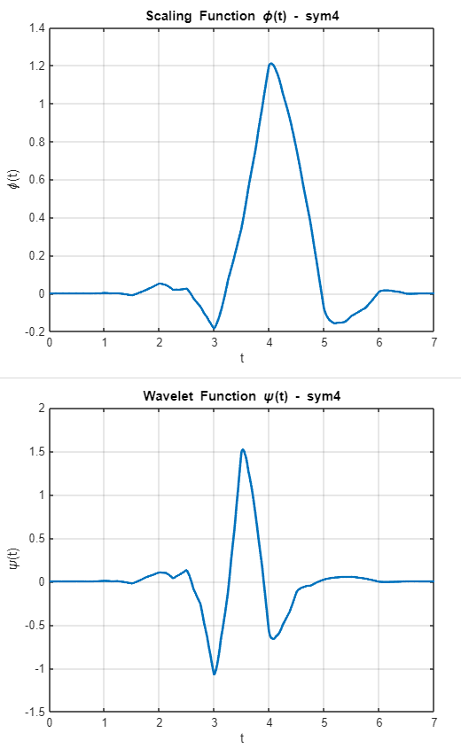
sym4

Slide 16
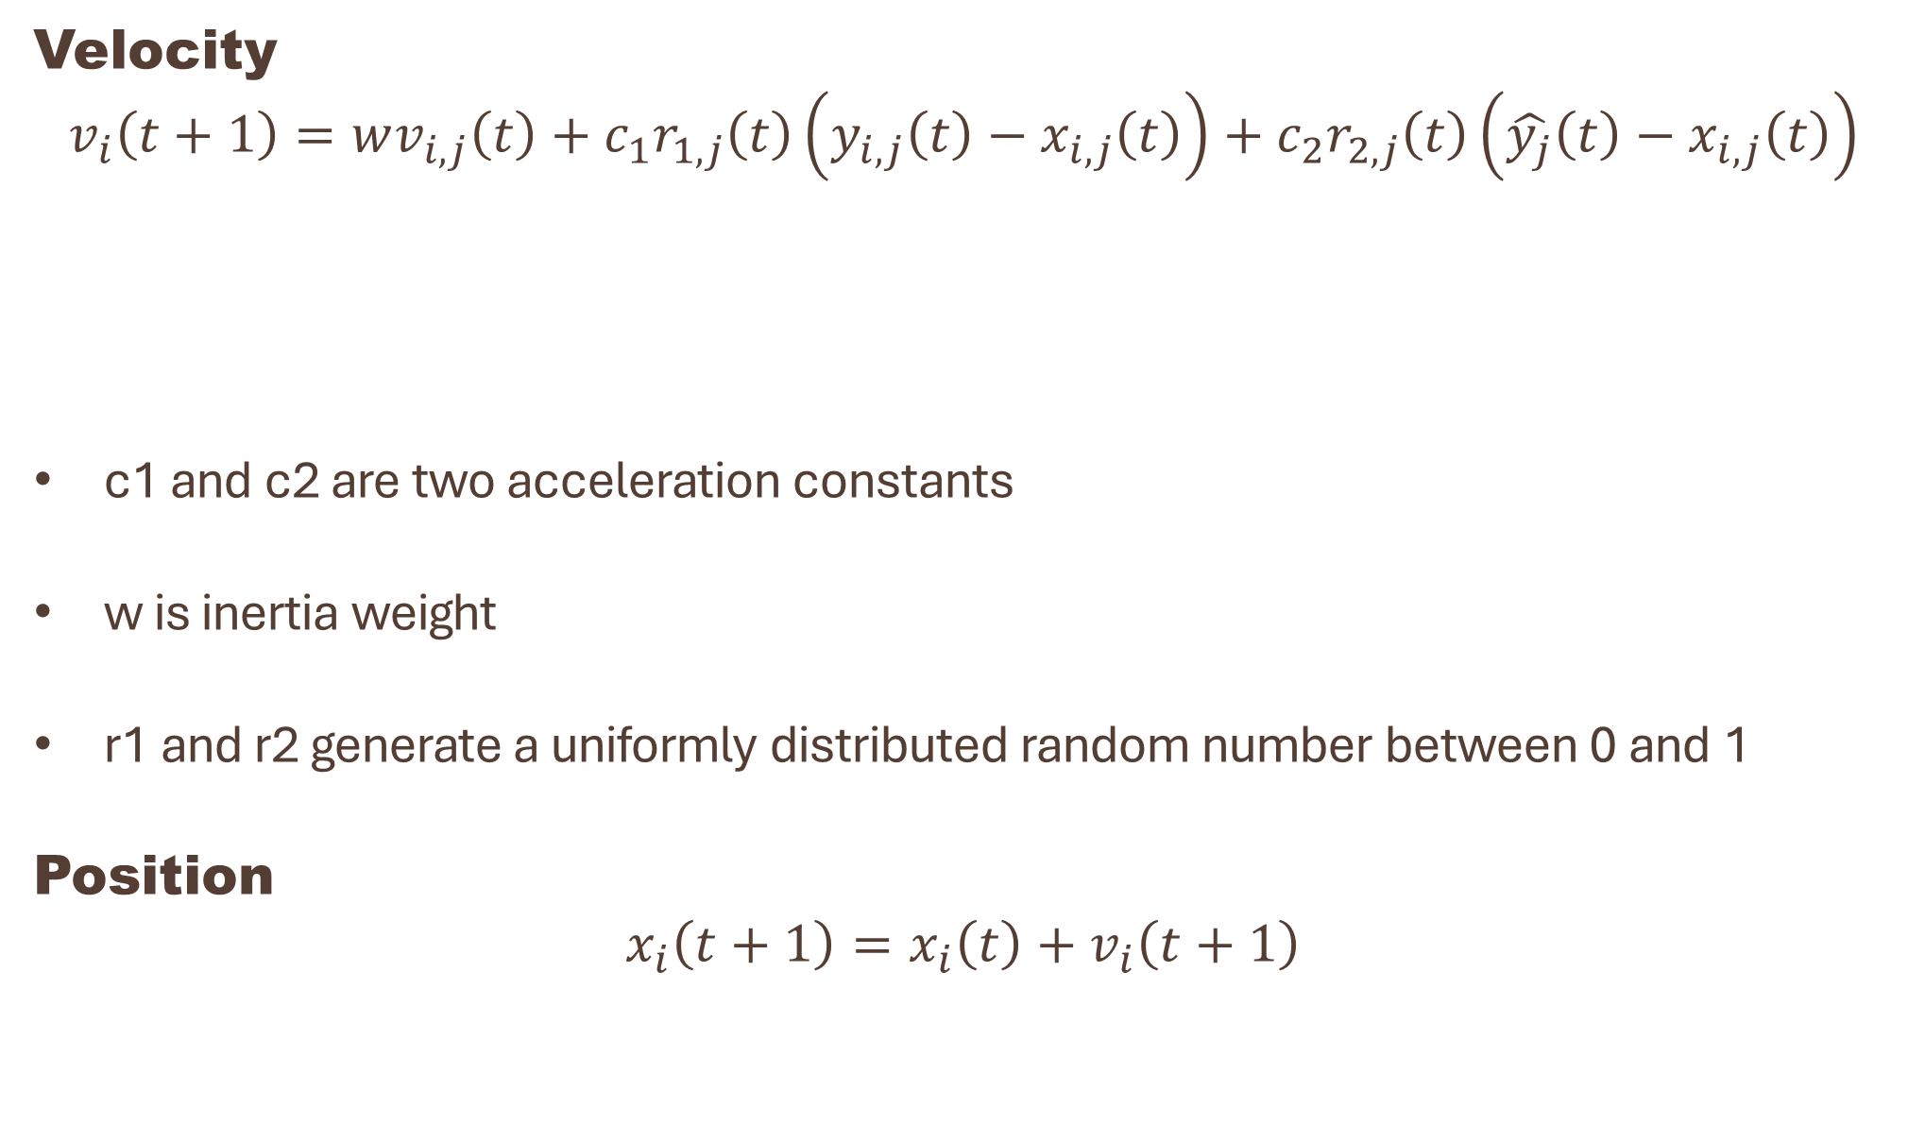


Velocity
$$v_{i}\left(t+1\right)=wv_{i,j}\left(t\right)+c_{1}r_{1,j}\left(t\right)\left(y_{i,j}\left(t\right)−x_{i,j}\left(t\right)\right)+c_{2}r_{2,j}\left(t\right)\left(\hat{y_{j}}\left(t\right)−x_{i,j}\left(t\right)\right)$$
c1 and c2 are two acceleration constants
w is inertia weight
r1 and r2 generate a uniformly distributed random number between 0 and 1
Position
$$x_{i}\left(t+1\right)=x_{i}\left(t\right)+v_{i}\left(t+1\right)$$
$\left(y_{i,j}\left(t\right)−x_{i,j}\left(t\right)\right)$ → Local Best
$\left(\hat{y_{j}}\left(t\right)−x_{i,j}\left(t\right)\right)$ → Global Best

Slide 17
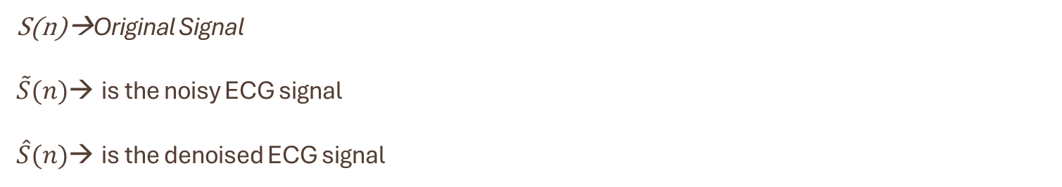
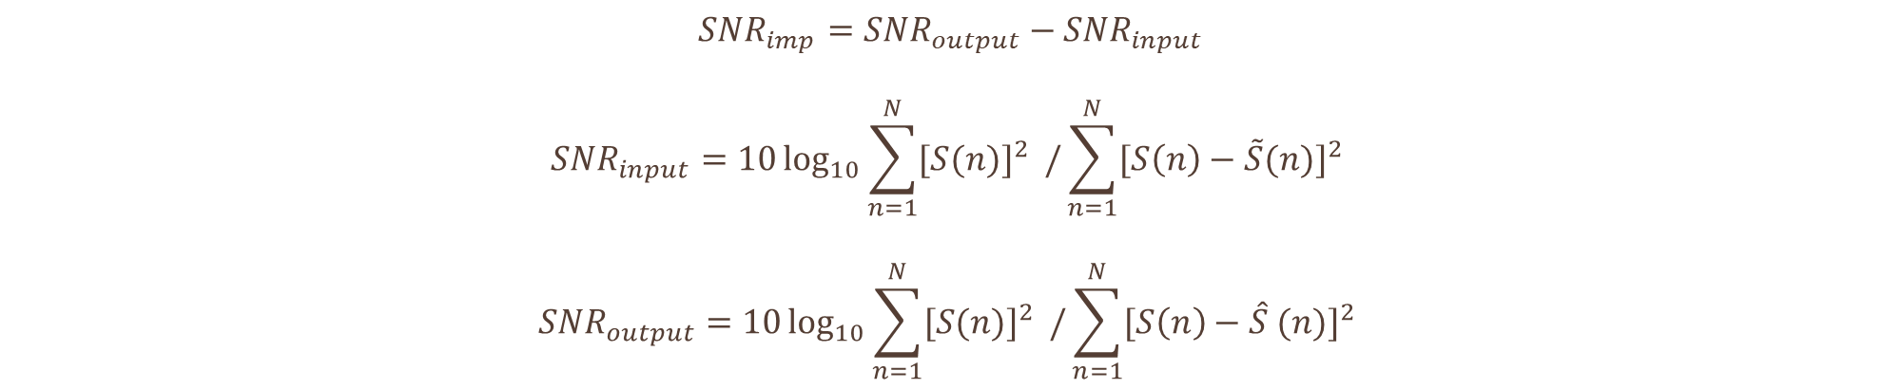
Fitness:
$${SNR}_{imp}={SNR}_{output}−{SNR}_{input}$$
$${SNR}_{input}=10\log_{10}{\sum_{n=1}^{N}{{[S(n)]}^{2} }/}\sum_{n=1}^{N}{{[S\left(n\right)−\tilde{S}(n)]}^{2} }$$
$${SNR}_{output}=10\log_{10}{\sum_{n=1}^{N}{{[S(n)]}^{2} }/}\sum_{n=1}^{N}{{[S\left(n\right)−\hat{S} (n)]}^{2} }$$
S(n)→Original Signal
$\tilde{S}(n)$→ is the noisy ECG signal
$\hat{S}(n)$→ is the denoised ECG signal

Slide 18
Toy Example:
Index | Wavelet
1 | coif1
2 | coif3
3 | sym3
4 | sym5
5 | db4
6 | db6
Index | Threshold rule
1 | Rigsure
2 | Sqtwolog
3 | Heursure
4 | minimaxi
Index | Rescaling
1 | one
2 | sln
3 | mln
Index | Threshold
1 | soft
2 | hard

Slide 19
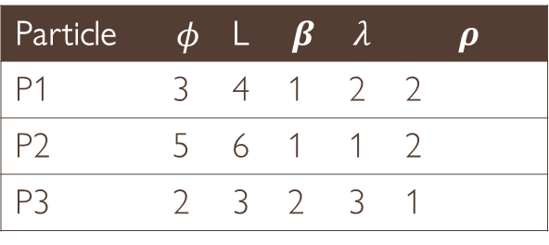
Particle | $$φ$$ | L | $$β$$ | $$λ$$ | $$ρ$$
P1 | 3 | 4 | 1 | 2 | 2
P2 | 5 | 6 | 1 | 1 | 2
P3 | 2 | 3 | 2 | 3 | 1
Particle | Pbest
P1 | [3,4,1,2,2]
P2 | [5,6,1,1,2]
P3 | [2,3,2,3,1]
gbest=P2
Because of High Fitness
Particle | Velocity.L
P1 | 0
P2 | 0
P3 | 0
w=0.7
c1=2
c2=2
r1=0.4
r2=0.6
Particle | Fitness
P1 | 7
P2 | 9
P3 | 5
Velocity =w*velocity+C1*r1*(pbest – particle)+C2*r2*(gbest - particle)
W*velocity=0.7*0=0
c1*r1*(pbest – particle)=2*0.4*(4-4)=0
c2*r2*(gbest - particle)=2*0.6*(6-4)=2.4
New Velocity is 2.4

Slide 20
Position Update
Particle.L=round(L+velocity)
L=4+2.4=6.4
L=6
Random Reset of Other Parameters
We are changing only the Level(L) parameter,moving towards the gbest

Slide 21
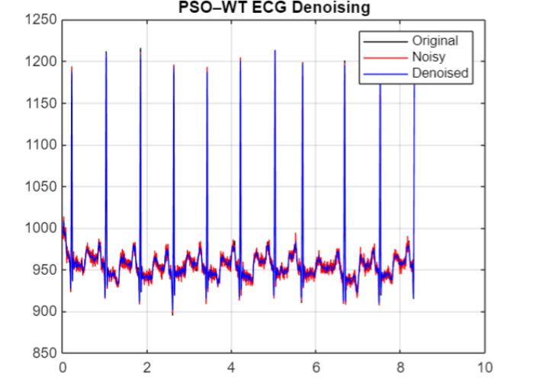
RESULTS

Slide 22
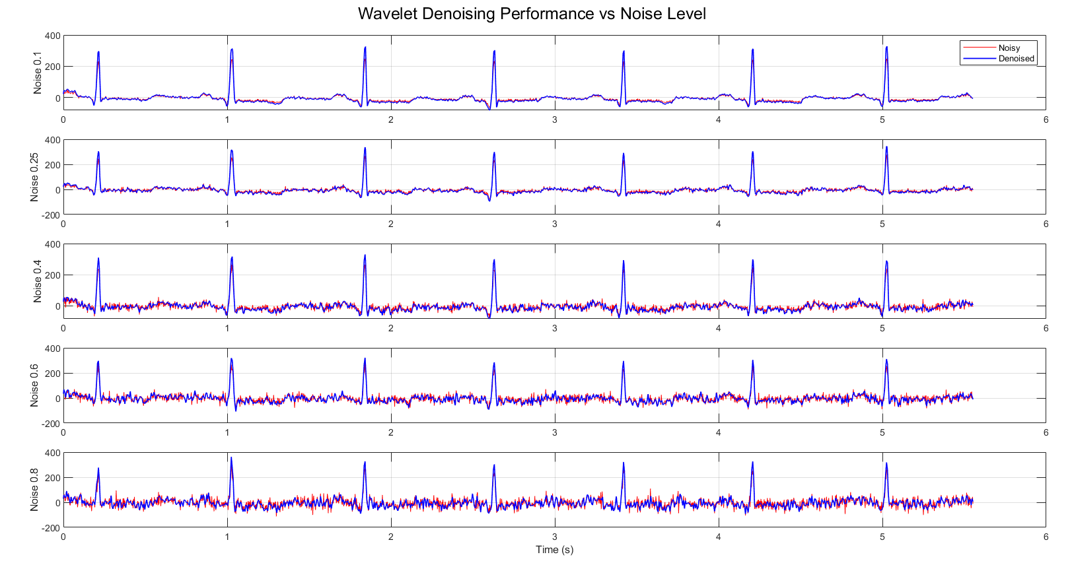

Slide 23
Thank You

